Slide 1
Personal Accident Insurance Reporting Portal
Team Members
1.Prema.S
2. Vigneshwaran.S
3.Shree ram Kumar.P
Facultyguide : Industrial guide :
Mrs.Suganthi.A Ms.Megala.P
Assistant professor Designation
Department of CSE
Department of CSE, KGiSL Institute of Technology, Coimbatore

Slide 2
Abstract
A personal Accident Insurance Reporting Portal is a self service reporting tool that allows you to quickly and effectively retrieve the most current claims reports for your policy anywhere ,anytime.
A personal accident insurance covers the risk of a death and it reduces the financial burden.
The portal allows for fast , secure, and private document sharing and in –depth analysis and reporting.
Department of CSE, KGiSL Institute of Technology, Coimbatore

Slide 3
Area Introduction-Existing system
Area Introduction:
A Personal accident policy gives financial relief to insured people if they sustain any injury/death duo to accidents.
Existing System:
In the existing system, the user can only report his/her policy information in the proposed form.
In Existing System if any changes made in Jasper reports that will reflect in other pages of the report.
Department of CSE, KGiSL Institute of Technology, Coimbatore

Slide 4
Proposed System
Simple access and user friendly.
The accident report form completed online also contains personal information about persons injured in workplace accidents.
The Reporting form consist of injured person’s name, date and time of incident, and location of the accident, detail description of accident.
The accident reporting portal and database is hosted internally on our premises in a secure server environment
Department of CSE, KGiSL Institute of Technology, Coimbatore

Slide 5
Literature Review
Drawbacks of existing methods
With the existing system the officials will not have any alerts unless he enters into the respective application.
References
Based on Accident Reporting Portal forms like policybazar.com
Jasper studio.
Department of CSE, KGiSL Institute of Technology, Coimbatore

Slide 6
Architectural Design (DFD and/or ER diagram)
Zero Level Data Flow Diagram:
Personal Accident
Insurance Reporting Portal
Details
DataBase
User
Login
Report Details
Department of CSE, KGiSL Institute of Technology, Coimbatore

Slide 7
First Level Data Flow Diagram
Reporting
First Name
DataBase
Login
Last Name
Location Of Incident
Date And Time
JasperStudio
Description
Report Generation

Slide 8
Module Split-up
Module 1: Create a login page
Module 2:Database connectivity for portal.
Module 3: Implement web portal
Module 4: Testing the web portal
Department of CSE, KGiSL Institute of Technology, Coimbatore

Slide 9
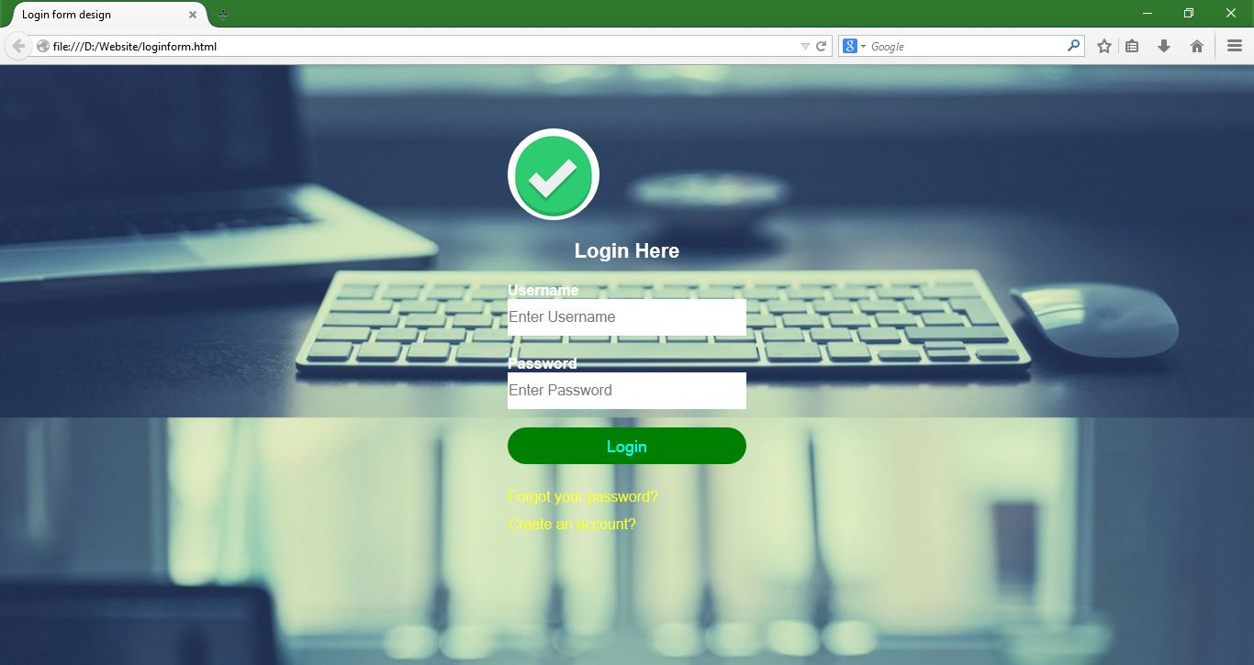
Screen shots of modules under progress.
Department of CSE, KGiSL Institute of Technology, Coimbatore

Slide 10
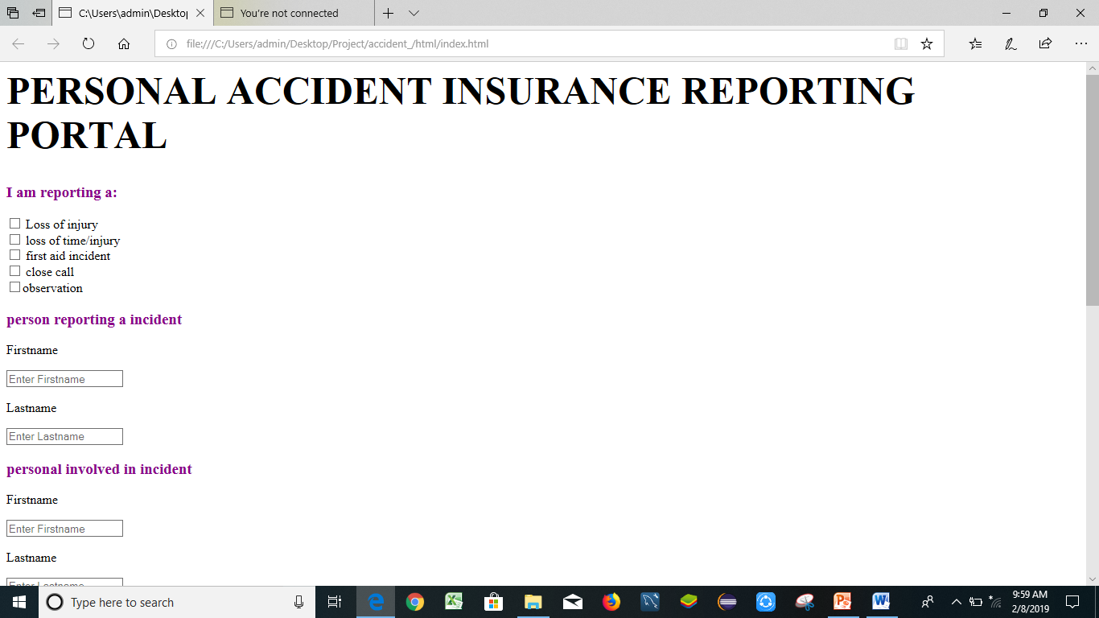

Slide 11
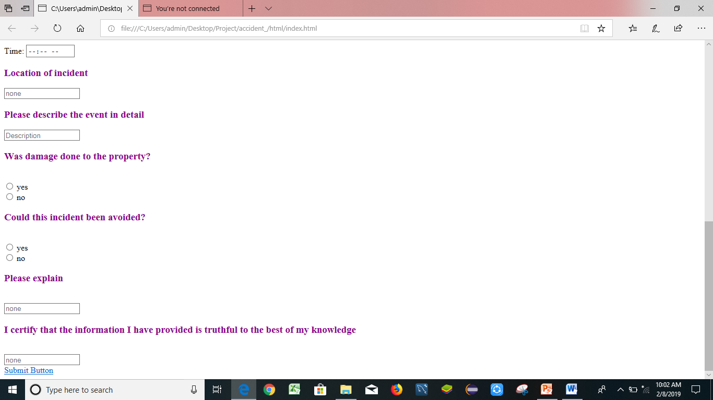

Slide 12
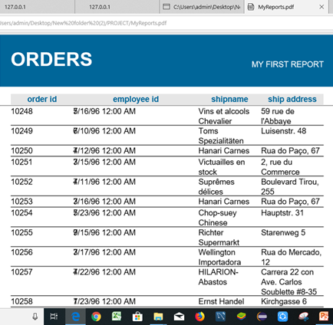

Slide 13
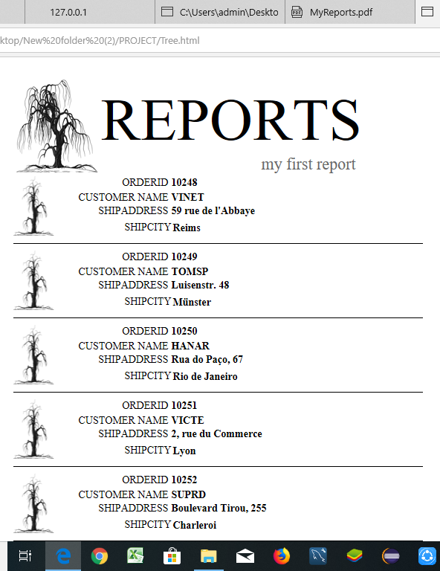

Slide 14
Thank You
Department of CSE, KGiSL Institute of Technology, Coimbatore

